Slide 1
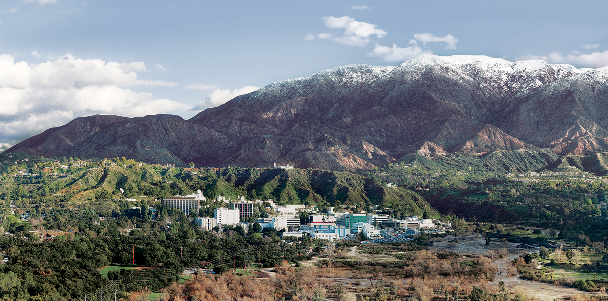
11. Optimal Estimation: Theory and Practice
Dr. David R. Thompson
Jet Propulsion Laboratory, Imaging Spectroscopy Group
July 20, 2019

Slide 2
Goals for this module
Apply Optimal Estimation to fit combined surface and atmosphere models
Construct new prior distributions
Correctly balance instrument and prior information

Slide 3
Orbital spectroscopy will necessitate improved atmospheric correction
Traditional atmospheric correction methods have trouble in certain conditions:
High water vapor
Extreme viewing angles
Surface/atmosphere coupling
Heavy aerosol loads
Orbital missions will access tropical and subtropical environments that:
Host a large fraction of Earth’s productivity and biodiversity
Are underrepresented in atmospheric correction research
Often have “difficult” atmospheres
Most current aerosol retrieval methods use dark or shadowed pixels that may not be apparent at orbital ground sampling resolutions
Existing methods generally disregard uncertainties, which are important to create bias-free global maps from multiple observations

Slide 4
Optimal Estimation (OE) Theory: Simultaneous estimation of surface and atmosphere
OE is one of a family of Bayesian model inversion approaches, and particularly common in remote sensing literature. Popularized by Clive Rodgers, [2000]
The basic idea is to create a comprehensive model of the surface/atmosphere system and fit all free parameters simultaneously.
It is a true spectroscopic retrieval that can exploit information distributed across the spectrum, helping to disentangle surface and atmosphere.
Also, OE’s rigorous probabilistic formulation incorporates ancillary measurements via the prior distribution.
Other advantages include:
Comprehensive uncertainty estimates that can inform downstream analyses and global maps
Flexible state vectors, more robust for difficult observing conditions
Elegance, conceptual simplicity
Notes:
Traditional atmospheric correction typically: (!) LUT generation of coefficients, (2) estimate of atmospheric state, (3) algebraic correction based on lambertian assumptions. Mature and effective; form basis of methods used in AVIRIS-NG standard products.
Several challenges to this…
limited size of state vector
Algebraic approximate solutions less accurate for extreme geometries
Uncoupled
Algebraic inversion means difficult to tease apart smooth atmospheric effects
Most inaccurate in regions of high haze, extreme water vapor causing absorption in scattering. India dataset contains pushes the frontier, excelelnt opportunity for investigating next level of precision.
Enabled by a fast radiative transfer model as an interior loop of an iterative max. a posteriori estimation

Slide 5
The “forward problem”
The forward problem involves predicting the measurement from some atmospheric and surface state. We already know how to do this pretty well.
State vector
Forward model
Measurement
5

Slide 6
The “inverse problem”
The inversion goes the other direction – it starts from a measurement and infers the most probable state. This is tougher because (a) there may be more unknowns than measurements, and (b) there is often instrument noise in the measurement.
Measurement
Inversion algorithm
Estimated state vector
6

Slide 7
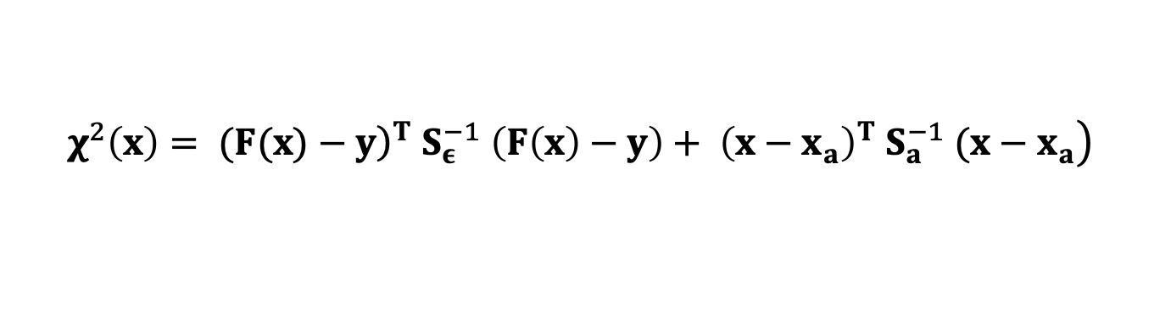
Maximum A Posteriori solution
Taking the logarithm of p(x | y), and ignoring terms that are constant with x, reduces the Maximum A Posteriori problem to the optimization:
… we can solve it by conjugate gradient descent.
$$\left.χ^{2}\left(x\right)= ({\left.F(x)−y\right)}^{T} S_{ε}^{−1} \left(F\left(x\right)−y\right)+ {\left(x−x_{a}\right)}^{T} S_{a}^{−1} (x−x_{a}\right)$$
Cost
Model match to measurement
Bayesian prior

Slide 8
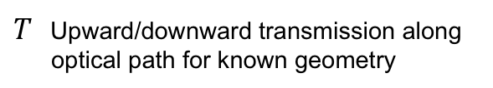
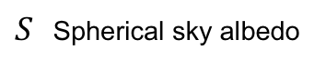
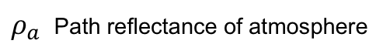
Reprise: “Classic” atmospheric correction is a sequential procedure
2. Analyze radiance to estimate this atmosphere (typically using band ratios).
Surface reflectance
TOA reflectance
Lookup table indexed by H₂O, etc.
3. Look up and/or interpolate optical coefficients
1. In advance, do RTM calculations for a grid of atmospheric conditions:
4. Algebraic Inversion
$ρ_{a}$ Path reflectance of atmosphere
$S$ Spherical sky albedo
$T$ Upward/downward transmission along optical path for known geometry
Notes:
With atmospheric state specified, We can get optical constants via linear lookup table interpolation (note: T=transmission, S=spherical sky albedo, rho_a is the path reflectance).
This is just one of several similar functional approximations to the actual radiative transfer solution. With atmosphere specified, we can invert it algebraically to recover the surface reflectance.
The conventional strategy is limited in sever

Slide 9
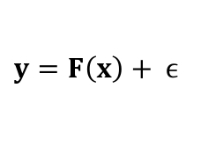
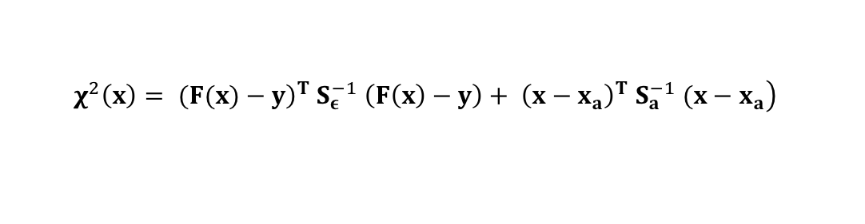
OE involves iterative, simultaneous estimation of atmosphere and surface
1. Predict radiance
$y=F\left(x\right)+ ϵ$
2. Optimize state vector
$$\left.χ^{2}\left(x\right)= ({\left.F(x)−y\right)}^{T} S_{ε}^{−1} \left(F\left(x\right)−y\right)+ {\left(x−x_{a}\right)}^{T} S_{a}^{−1} (x−x_{a}\right)$$
Cost
Model match to measurement
Bayesian prior

Slide 10
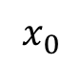
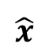
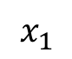
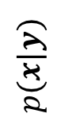
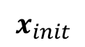
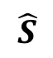
Pictoral representation
OE’s iterative optimization is like “hill climbing” of the probability, starting from our initial guess of the surface/atmosphere state. We can calculate a local linearized Gaussian error estimate (the ellipsoid) at the solution.
$$p(x|y)$$
$$\hat{x}$$
$$\hat{S}$$
$$x_{init}$$
$$x_{0}$$
x_{ATMOS}
$$x_{1}$$
x_{SURFACE}

Slide 11
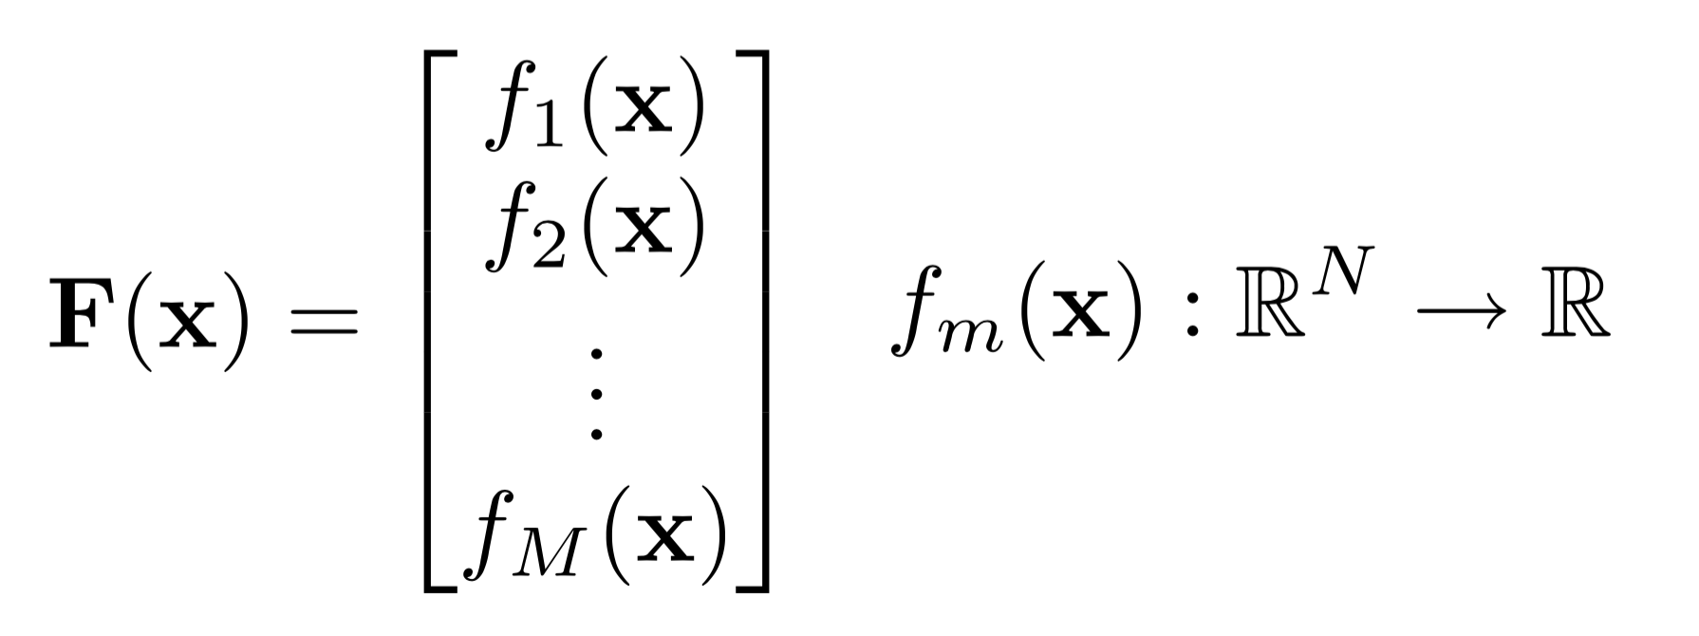
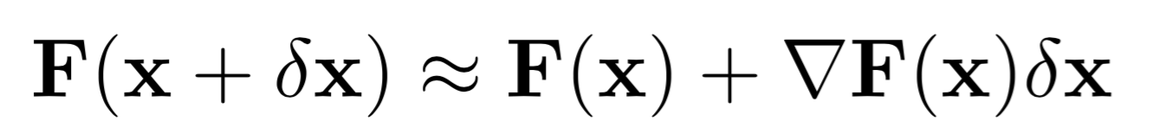
The Jacobian matrix
The Jacobian is an important part of the optimization, and it tells us a lot about our sensitivities to different state vector elements. It represents the state parameters’ influence on the observation.
Elements of :
Consider the first order Taylor series expansion:
A local approximation, which is exact for linear problems

Slide 12
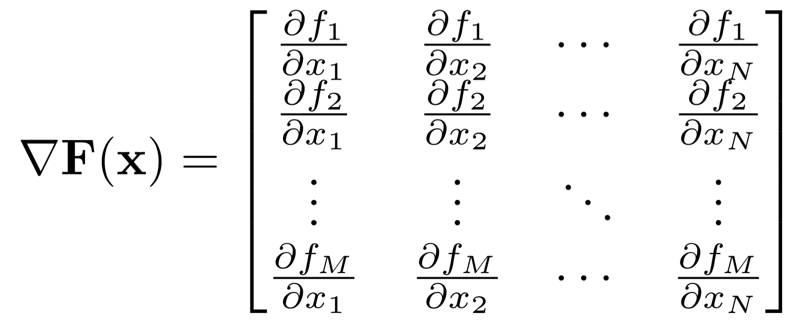
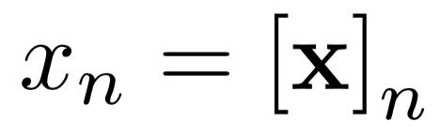
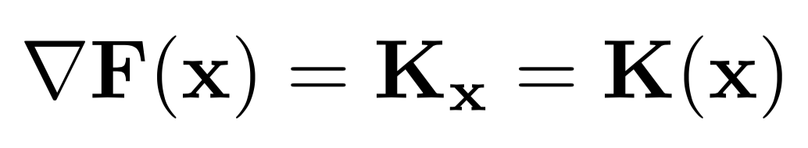
The Jacobian matrix
It can be written explicitly as:
where
A more compact form is simply:

Slide 13
The Jacobian matrix
A single reflectance value
Atmospheric H₂O column

Slide 14

Posterior predictive uncertainty
Our predictive uncertainty at the solution is a multivariate Gaussian distribution related to the linearized forward model, constrained by the prior.
$$\hat{S}={\left(K^{T}S_{ε}^{−1}K+S_{a}^{−1}\right)}^{−1}$$
$$p(x|y)$$
$$\hat{x}$$
$$\hat{S}$$
$$x_{init}$$
$$x_{0}$$
x_{ATMOS}
$$x_{1}$$
x_{SURFACE}

Slide 15
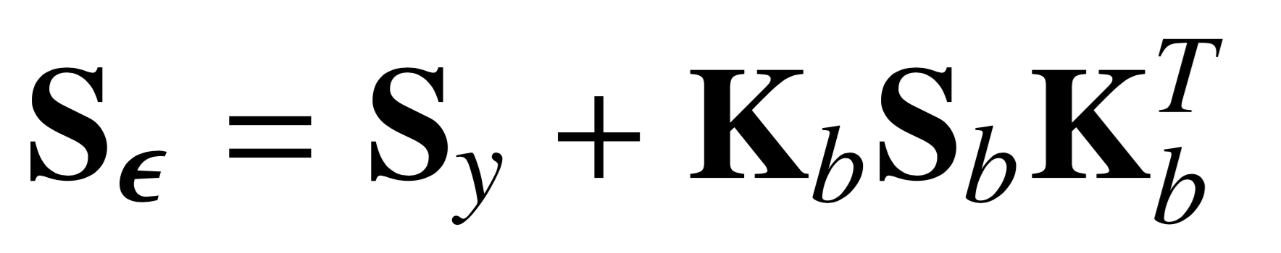
The observation noise
The observation noise term is very flexible. It typically incorporates both instrument noise as well as unknowns in the observation system that are not retrieved.
Total observation noise
Jacobian WRT unknowns
Measurement noise (instrument effects)
Photon noise
Read noise
Dark current noise
Unknown parameters in the observation system
Sky view factor
H₂O absorption coefficient intensity
Systematic radiative transfer error
Uncorrelated radiative transfer error

Slide 16

Components of the Forward Model (example)
Instrument: AVIRIS-NG
Instrument model with Wavelength- and signal-dependent SNR
Photon shot & read noise
Uncorrelated calibration uncertainty
Systematic calibration / RT uncertainty
Atmosphere: MODTRAN 6.0 RTM
DISORT MS, Correlated-k
Rural aerosol model
broad prior uncertainties
Unmodeled unknowns, including H₂O absorption coefficients
H₂O, AOD retrieved
Surface: Multi-component Multivariate Gaussians
Prior based on universal library, highly regularized to permit accurate retrieval of arbitrary shapes
Reflectance estimated independently in every channel
Pre-defined
Statistical, fit to data
Retrieved in the inversion

Slide 17
Example of multi-component surface models
We will often use multiple multivariate Gaussian priors. During initialization we select one appropriate for the surface type. More information in future presentations…
[Thompson et al., Remote Sensing of Environment 216, 2018]

Slide 18
Reflectance estimate vs. in situ
Comparisons against surface measurements demonstrate accurate retrievals
Wavelength (nm)
Wavelength (nm)
[Thompson et al., Remote Sensing of Environment 216, 2018]
Notes:
Good agreement!

Slide 19
Aerosol fitting results
AOD550 estimates for AVIRIS-NG India campaign
Simultaneous estimation of surface and atmosphere parameters can account for aerosol distortions
We retrieve three optical types (best interpreted as structured error terms rather than physical particle properties)
Validation on a large segment of the AVIRIS-NG campaign in India, which experienced high water vapor and AOD loadings
[Thompson et al., Remote Sensing of Environment, 232, 2019].
Aerosol type
fractions
Aerosol type
fractions
Original
OE solution
Original method
New approach
Aerosol distortion
Aerosol-related H₂O vapor distortions
H₂O vapor distortions

Slide 20
Modeling assumptions affect the relative weighting of measurement and prior
Instrument noise and calibration uncertainty cause the retrieval to rely more on the prior, and less on the instrument measurement. In this example, the retrieval becomes “smoother” as we increase the presumed calibration error.
Wavelength (nm)
[Thompson et al., Remote Sensing of Environment 216, 2018]

Slide 21
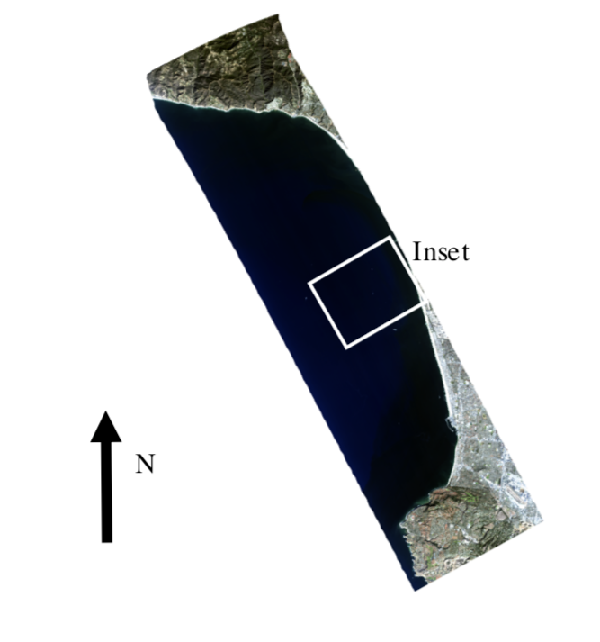
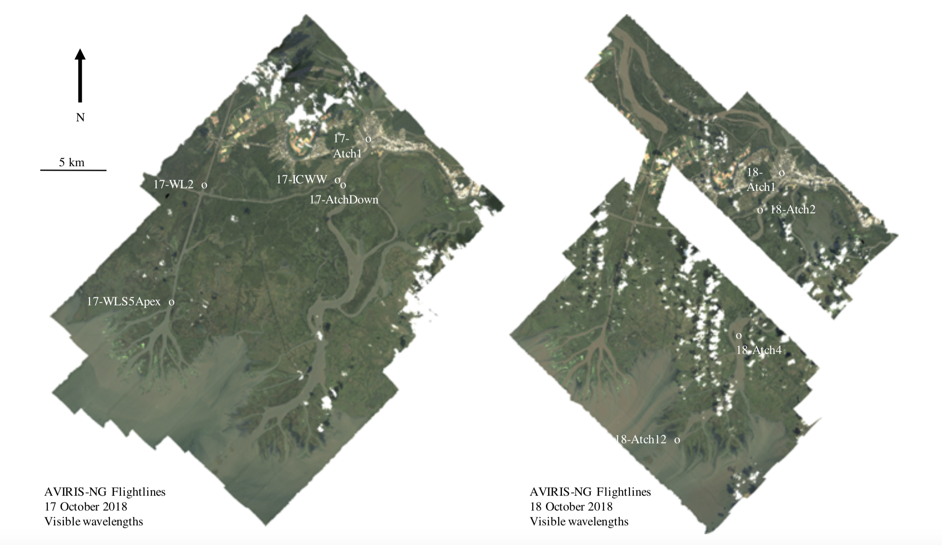
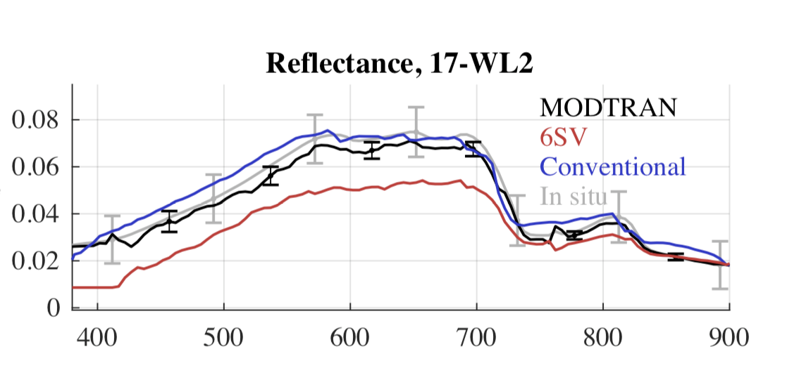
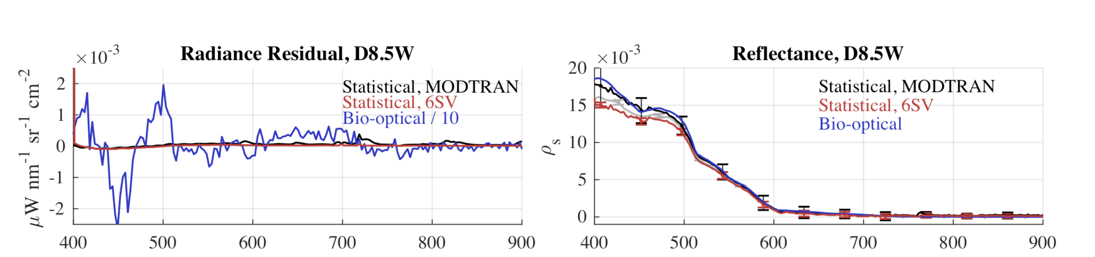
Coastal environments
Experiments demonstrate that the same method works for clear and turbid water.
Wavelength (nm)
Wavelength (nm)
[Thompson et al., Remote Sensing of Environment 216, 2018]
Notes:
Posterior uncertainty predictions (grey envelopes) accurately predict and capture our actual discrepancies!
This demonstrates a closed account of the uncertainty in the system. To our knowledge, this is the first time it has been done for VSWIR imaging spectroscopy.
Note: we also account for the uncertainty in the surface measurement, which is a significant contributor to the confidence bands.

Slide 22
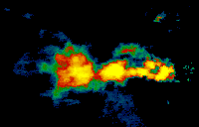
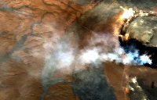
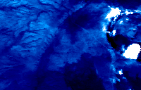
Example: Volcanic AOD observations
Combined estimate of H₂O vapor, AOT, surface reflectance and temperature
Applying the retrieval to an entire image allows pixelwise AOD mapping, as in this example of a volcanic plume.
Aerosol Optical Depth at 550 nm
Hot crater
AVIRIS-C f170127t01p00r16
(subset, visible bands)
Aerosol Optical Depth Uncertainty
[Realmuto, Thompson, et al., in preparation]

